Slide 1

Module 1 Lesson 3 – R and RStudio
Mental Health Dashboard Building
Module 1 – Data Acquisition and Cleaning
Maria Tomasso, M.S.
met48@txstate.edu
July 2023

Slide 2
LAST TIME

Slide 3
IN THIS VIDEO
We will discuss the R programming language and RStudio integrated development environment (IDE)
We will install R and RStudio
We will explore the RStudio interface
We will write and run our first R script

Slide 4
WHAT IS R?
R is a programming language that was developed by statisticians for data analysis and visualization.
Programming languages act as an intermediary between the programmer and the computer.
R is open-source (free) and popular in industry, academia, and healthcare.
R’s main competitors are Python, Scala, and SAS.

Slide 5
WHAT IS RSTUDIO?
RStudio is an integrated development environment (IDE) for R and Python.
IDE’s provide tools that make programming easier. These tools include code editors, debuggers, package managers, and environment views.
We will go over RStudio’s tools in more detail later.
It is possible to use R without RStudio, but RStudio helps write code more quickly with fewer errors.

Slide 6
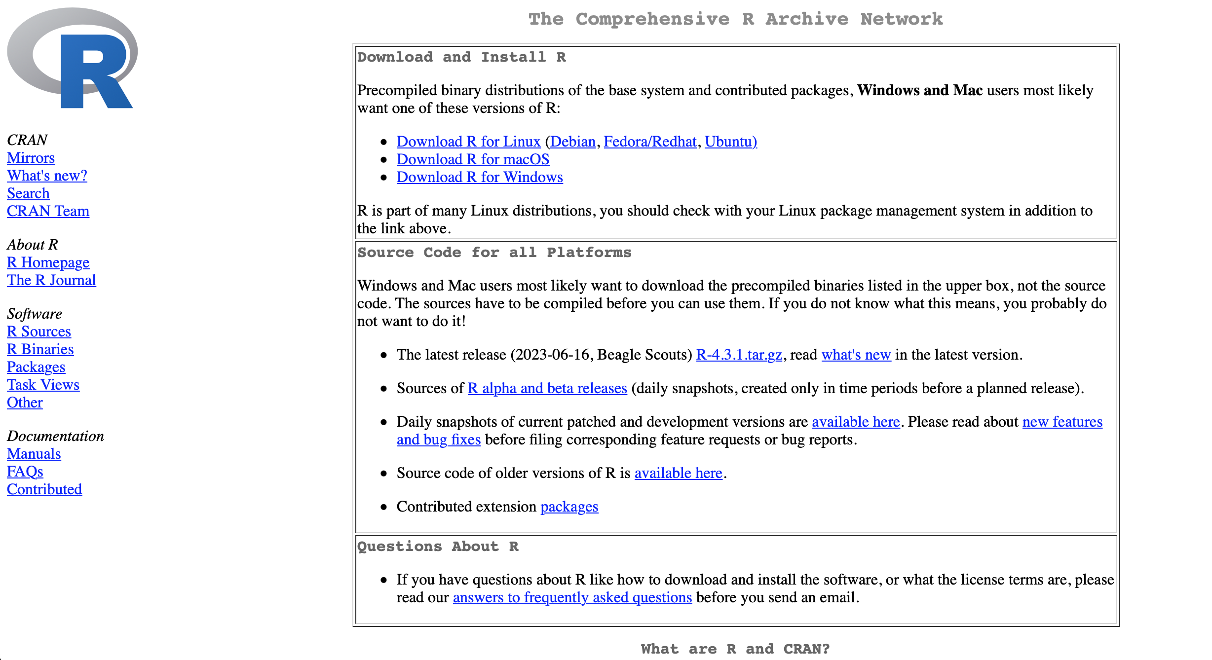
INSTALLATION - R
Download R from https://cran.r-project.org. This website is safe; do not download R from any other sources.
Use these links to download the version of R that is appropriate for your system. We will show installation for macOS and Windows.

Slide 7
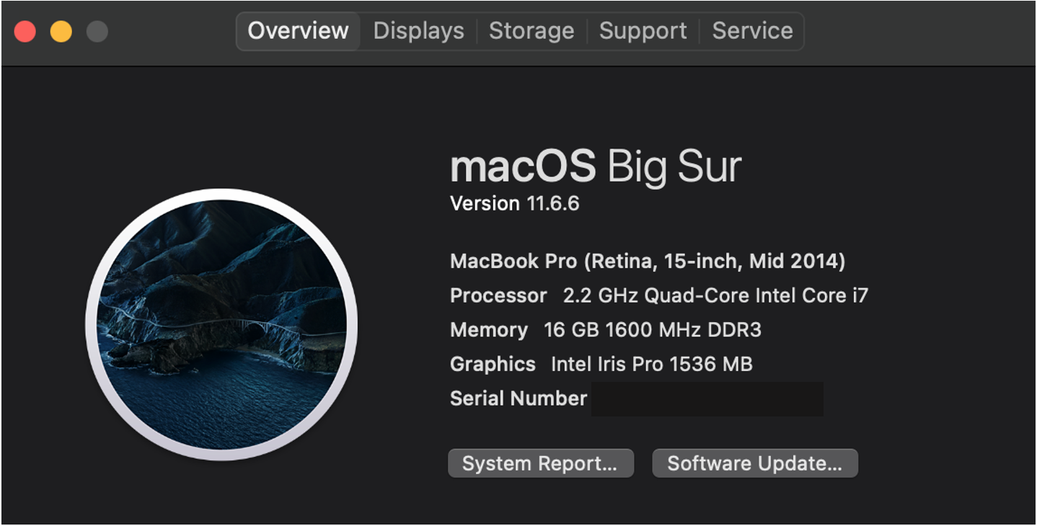
INSTALLATION – R (macOS)
First, check your processors and operating system version by clicking the Apple symbol is the upper left corner of the screen.
Click ‘About This Mac’
Look at the version number for the operating system number and processor for M1/M2
The example image shows a MacBook running version 11 of macOS that does NOT use M1/M2 processors.

Slide 8
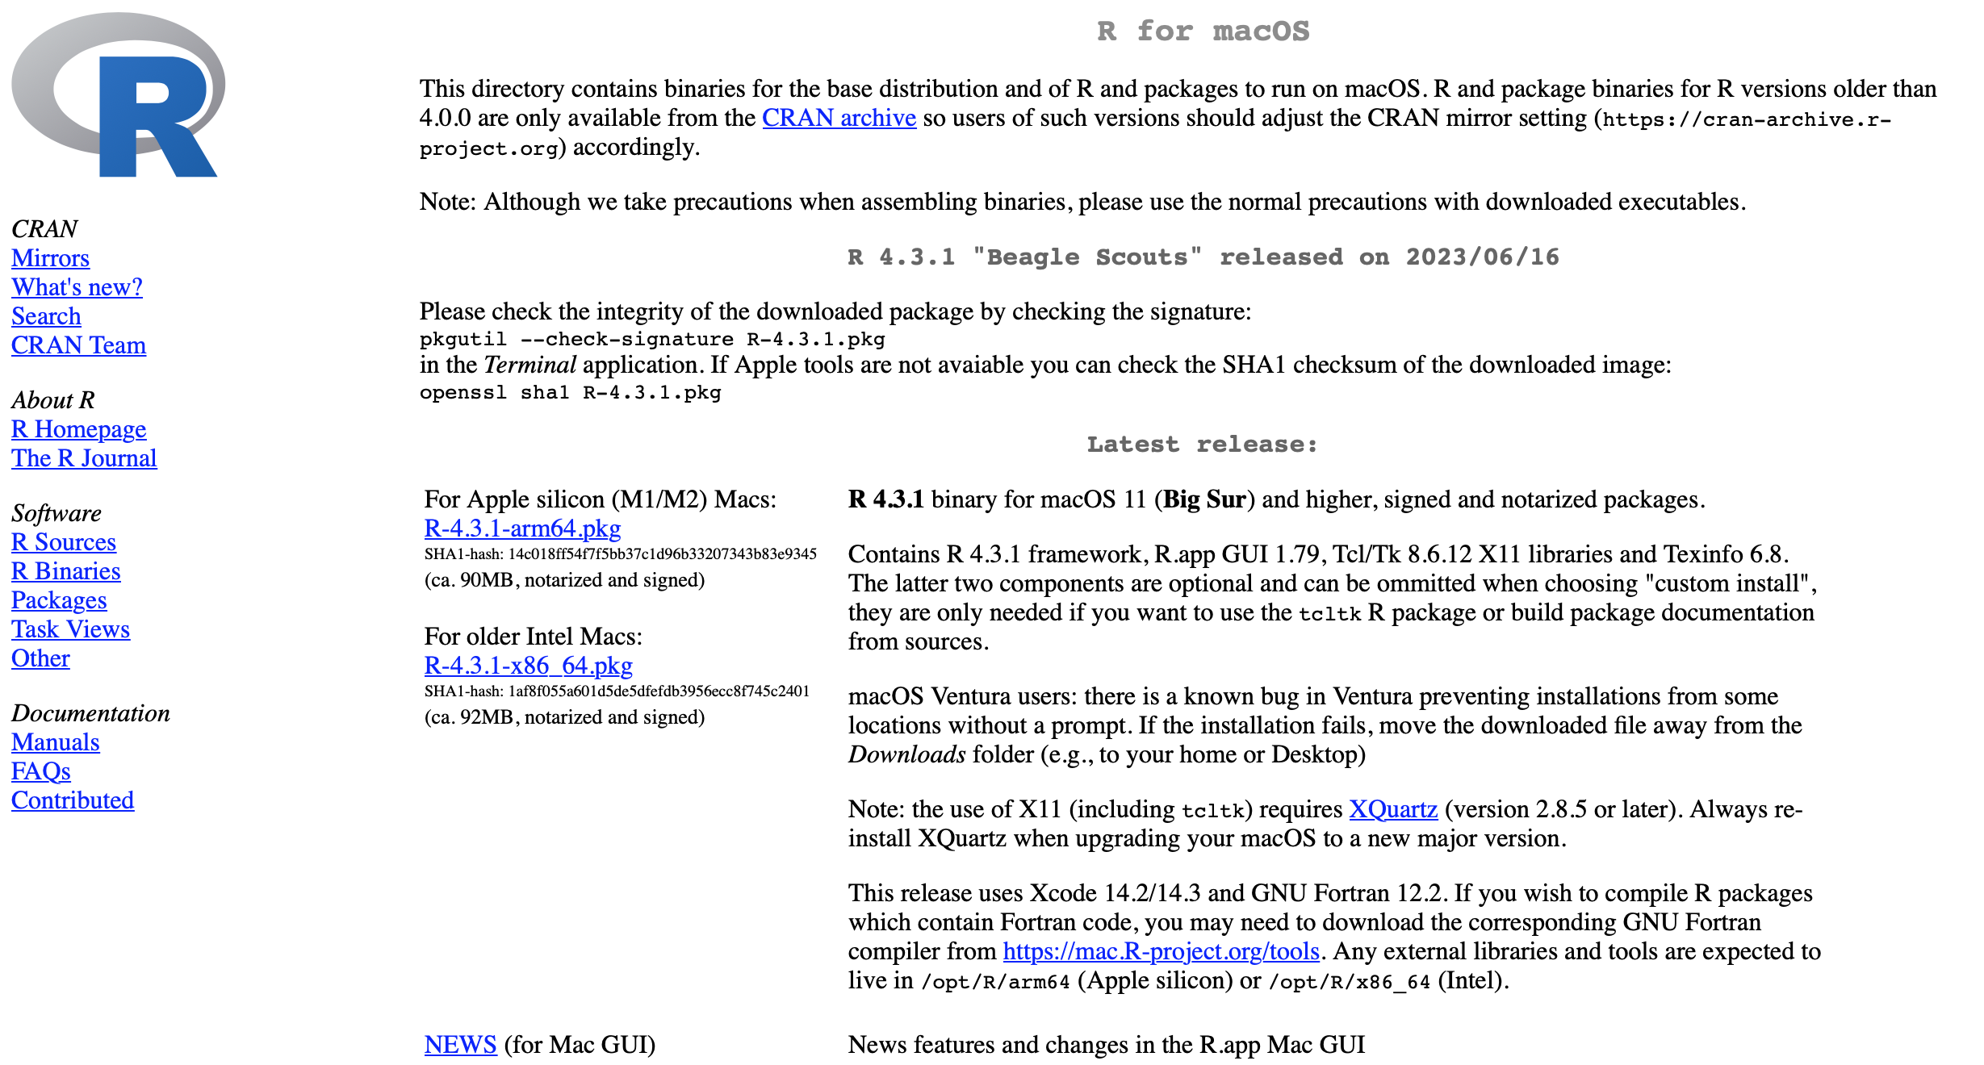
INSTALLATION – R (macOS)
Click here for M1/M2 Macs
Click here for older Macs (must run macOS 11 or higher)

Slide 9
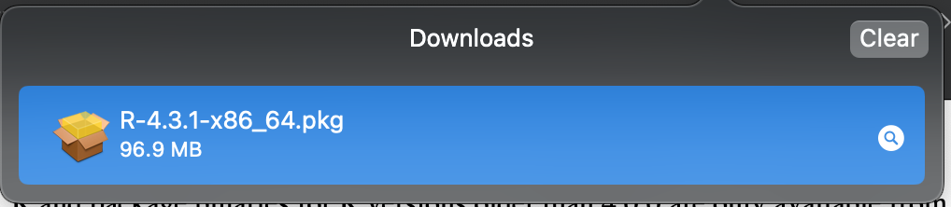
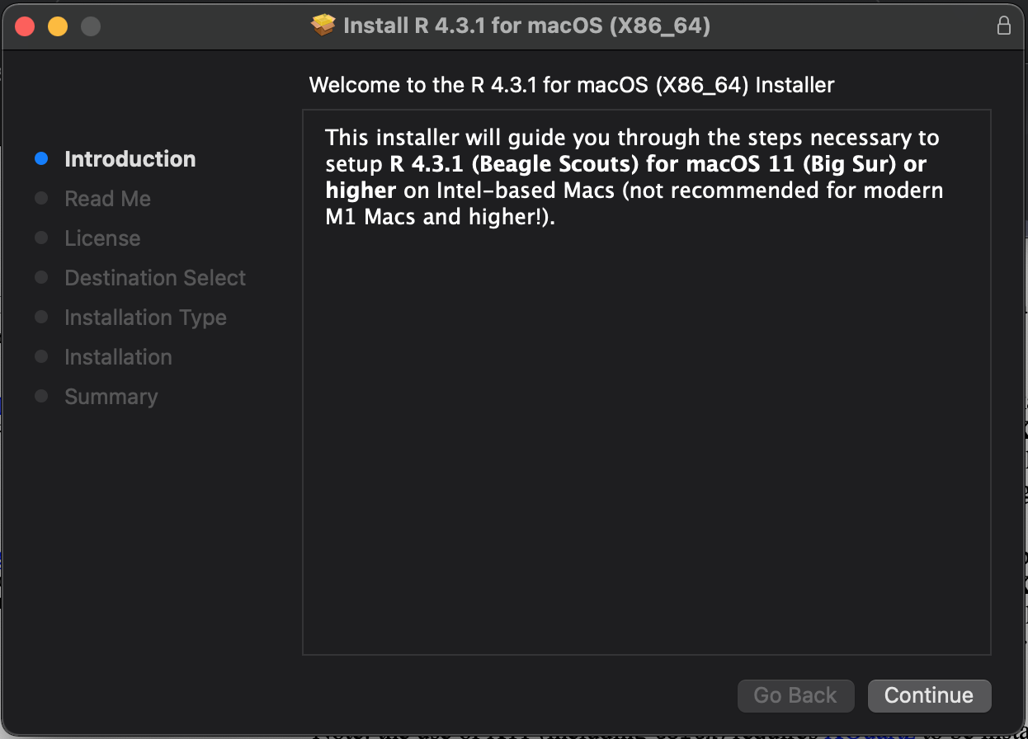
INSTALLATION – R (macOS)
Double click the file that appears in ‘Downloads’ and follow the on-screen instructions.
We’re done!

Slide 10
INSTALLATION – R (Windows)

Slide 11
INSTALLATION – RSTUDIO

Slide 12
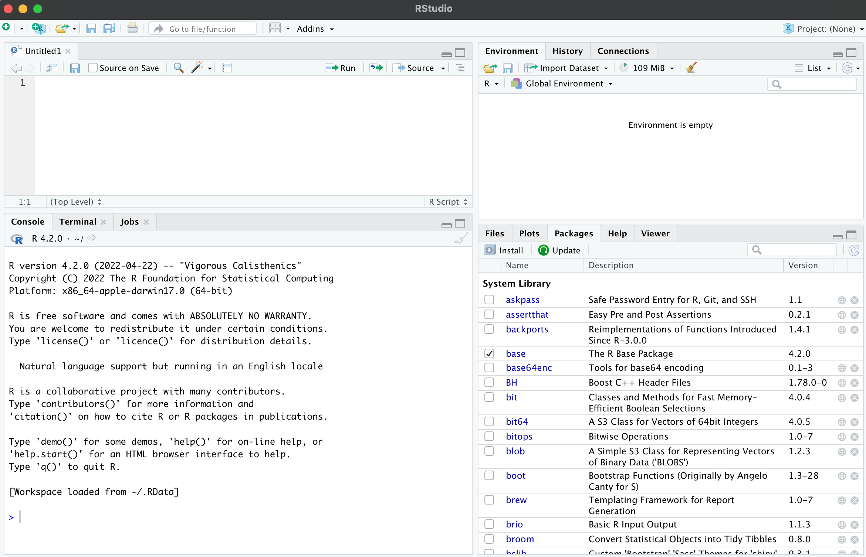
RSTUDIO ORIENTATION
The environment pane shows variables and their values, among other things.
Programs can be written and saved in this pane.
This pane can show the files in the current working directory, the packages that are installed and in use, and any plots or visualizations generated.
Program output goes here.

Slide 13
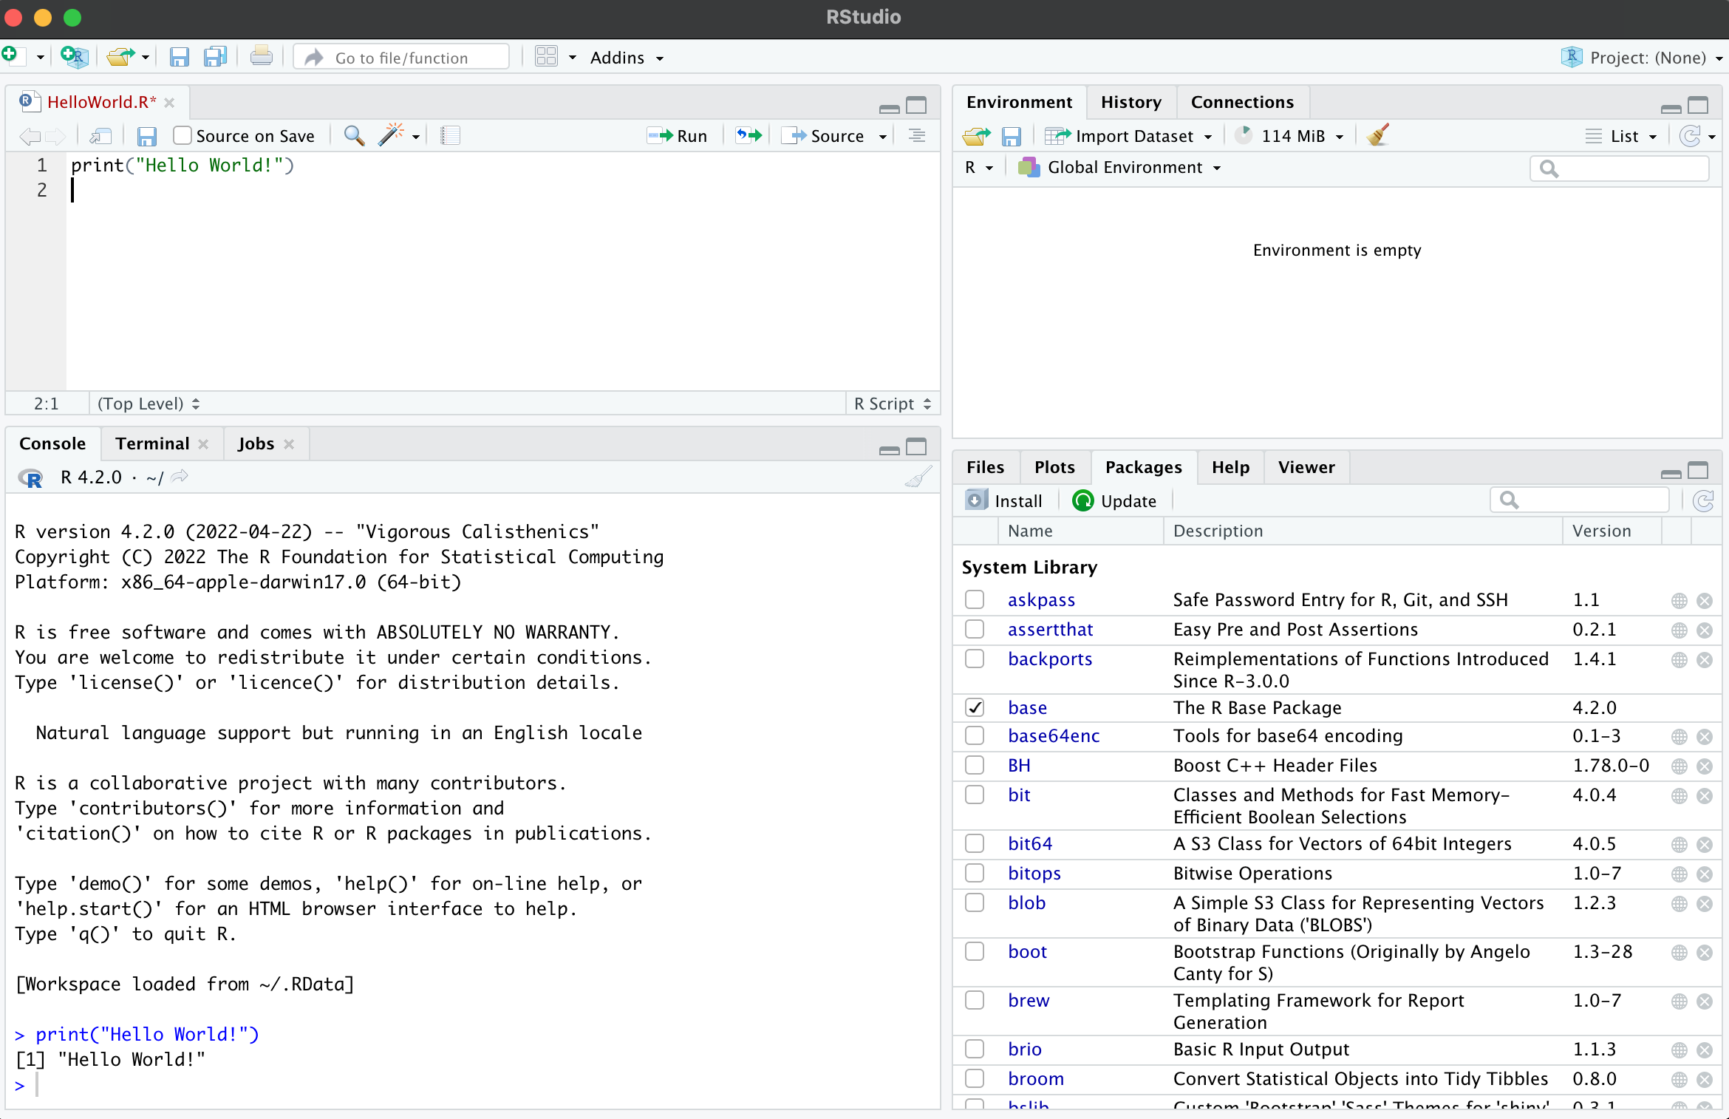
“Hello World!”
‘Run’ button runs the code.
Code is written here.
Code output is visible here.

Slide 14
RECAP
In this video, we installed R and RStudio and wrote our first R program.

Slide 15
WHAT’S NEXT?
PRACTICE: Install R and RStudio on your own device. Starting with the “Hello World” script we created in this video, modify it to output a different phrase of your choosing.

Slide 16





FOLLOW US
https://public.tableau.com/app/profile/translational.health.research.center
https://twitter.com/txst_thr
https://healthresearch.txst.edu/
https://www.linkedin.com/company/texas-state-university-translational-health-research/
https://www.youtube.com/@txst_THR

